Slide 1

Transaction Control Statements
Database Management System | SQL and Advanced Query Formulation
Course: Database Management System | Chapter: SQL and Advanced Query Formulation | Program: Bachelor of Engineering
DISCOVER · LEARN · EMPOWER
Notes:
Welcome everyone to today's session on Transaction Control Statements. We are diving deep into the SQL and Advanced Query Formulation chapter. As engineers, mastering these statements is crucial for ensuring data integrity in real-world applications. Let us begin our journey to Discover, Learn, and Empower.

Slide 2
Course Outcomes
SLIDE 2 / 14
Course Outcome
CO | BT LEVEL | DESCRIPTION
CO1 | BT2 | Explain database architecture, relational model concepts and formal query language foundations including relational algebra and relational calculus.
CO2 | BT3 | Apply relational algebra, relational calculus and SQL constructs to formulate correct and efficient database queries.
CO3 | BT4 | Analyze functional dependencies and design normalized relational schemas up to 5NF ensuring lossless join and dependency preservation.
CO4 | BT4 | Analyze transaction schedules and concurrency control mechanisms to determine serializability, recoverability and correctness.
CO5 | BT5 | Evaluate storage structures, indexing strategies and query optimization techniques for performance, scalability and reliability.
Chandigarh University
2 / 14
Notes:
Today's lecture directly addresses CO4 and CO5. We will analyze how transaction schedules ensure correctness and recoverability. You will also evaluate how these statements impact performance and scalability. Understanding these outcomes is key to your engineering success.

Slide 3
Learning Objectives
SLIDE 3 / 14
Learning Outcomes
1
Analyze the atomicity and consistency properties of transaction control statements.
2
Evaluate the impact of COMMIT and ROLLBACK on database state.
3
Determine the correct usage of SAVEPOINT for partial recovery scenarios.
4
Assess the role of transaction isolation levels in concurrency control.
5
Construct robust SQL scripts handling complex multi-step operations.
Chandigarh University
3 / 14
Notes:
By the end of this lecture, you will be able to analyze atomicity and consistency deeply. You will evaluate how COMMIT and ROLLBACK affect the final database state. We will also determine the correct usage of SAVEPOINT for partial recovery. Finally, you will assess isolation levels for concurrency control.

Slide 4
Lecture
SLIDE 4 / 14
Definition of Transaction Control
THEY ENSURE THE ACID PROPERTIES
Atomicity, Consistency, Isolation, Durability.
• Transaction control statements manage the logical grouping of SQL operations.
• Without these statements, partial updates can corrupt the database state.
• They define the boundaries where a group of actions becomes permanent.
• These statements are essential for maintaining data integrity in concurrent systems.
• They allow developers to explicitly control the start and end of transactions.
Chandigarh University
4 / 14
Notes:
Transaction control statements manage the logical grouping of SQL operations to ensure data integrity. They are the guardians of the ACID properties: Atomicity, Consistency, Isolation, and Durability. Without these statements, partial updates can corrupt the database state significantly. They define the precise boundaries where a group of actions becomes permanent.

Slide 5
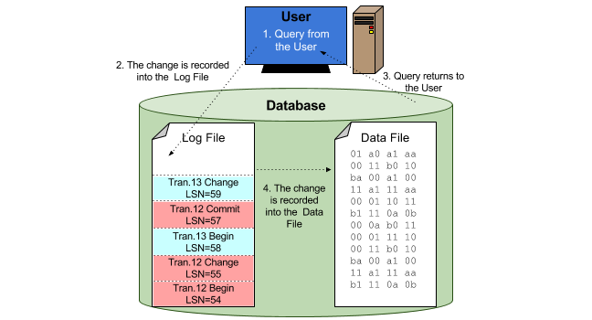
Lecture
SLIDE 5 / 14
The COMMIT Statement
1
COMMIT makes all changes made in the current transaction permanent.
2
It releases all locks held by the transaction on data objects.
3
Once committed, the changes cannot be undone by a ROLLBACK command.
4
It signals the successful completion of a logical unit of work.
5
Implicit commits occur after DDL statements in many database systems.
6
Explicit commits are required for DML operations to persist data.
Source: sqlbak.com
Chandigarh University
5 / 14
Notes:
The COMMIT statement makes all changes made in the current transaction permanent. It releases all locks held by the transaction on data objects immediately. Once committed, the changes cannot be undone by a ROLLBACK command ever. It signals the successful completion of a logical unit of work for the user.

Slide 6
Lecture
SLIDE 6 / 14
The ROLLBACK Statement
1
ROLLBACK undoes all changes made in the current transaction.
2
It restores the database to the state before the transaction began.
3
It is used when an error occurs or business logic fails.
4
It releases all locks held by the transaction on data objects.
5
It ensures atomicity by treating the transaction as if it never happened.
6
It can be issued explicitly by the user or implicitly by the system.
Chandigarh University
6 / 14
Notes:
ROLLBACK undoes all changes made in the current transaction completely. It restores the database to the state before the transaction began. It is used when an error occurs or business logic fails during execution. It ensures atomicity by treating the transaction as if it never happened.

Slide 7
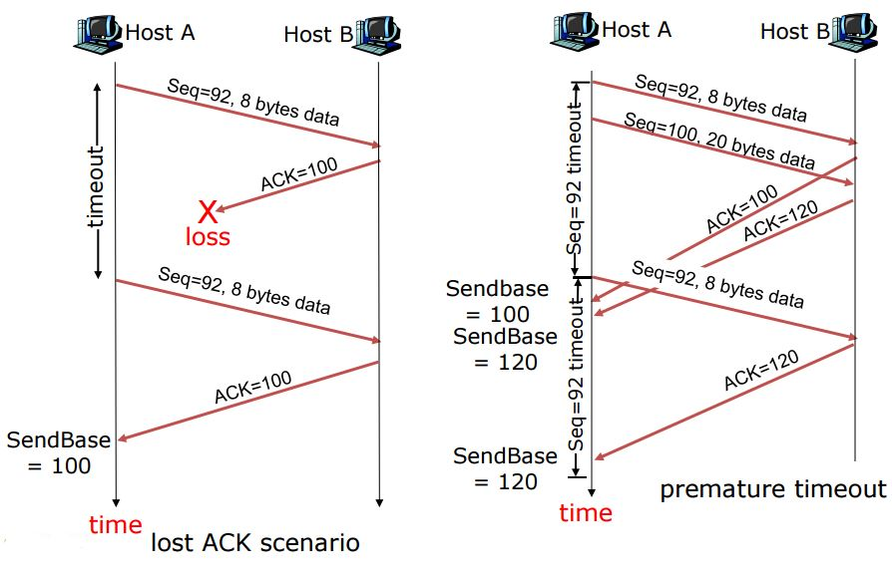
Lecture
SLIDE 7 / 14
SAVEPOINT Mechanism
SYNTAX
SAVEPOINT marker_name; allows defining named checkpoints.
• SAVEPOINT creates a marker within a transaction for partial rollback.
• It allows rolling back to a specific point without losing all work.
• It is useful for complex transactions with multiple logical sub-steps.
• ROLLBACK TO marker_name reverts changes made after the savepoint.
• It improves user experience by allowing error recovery without full restart.
Source: d2vlcm61l7u1fs.cloudfront.net
Chandigarh University
7 / 14
Notes:
SAVEPOINT creates a marker within a transaction for partial rollback capabilities. It allows rolling back to a specific point without losing all previous work. It is useful for complex transactions with multiple logical sub-steps. Syntax involves defining named checkpoints to allow flexible error recovery.

Slide 8
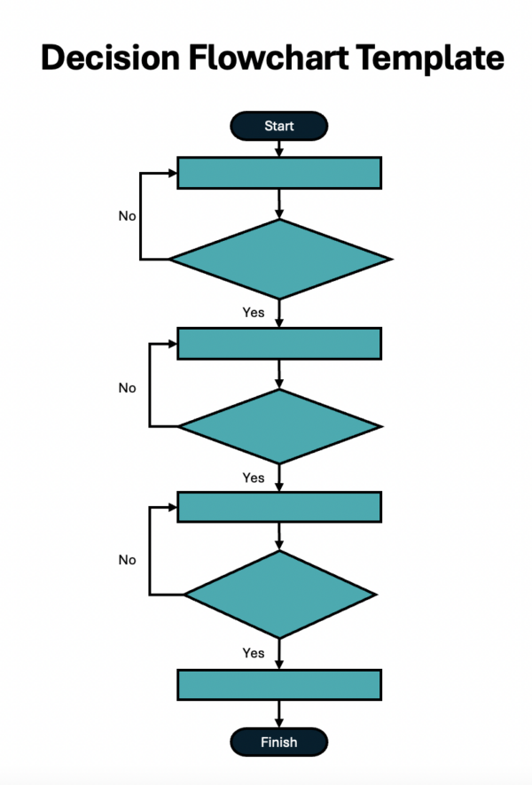
Worked Example
SLIDE 8 / 14
Transfer Logic
GOVERNING EQUATION
Step 1: UPDATE accounts SET balance = balance - 500 WHERE id = A
SCENARIO
Transfer 500 from Account A to Account B.
STEP 2
UPDATE accounts SET balance = balance + 500 WHERE id = B.
ERROR
If Step 2 fails, ROLLBACK restores Account A to original value.
SUCCESS
If both steps succeed, COMMIT makes the transfer permanent.
RESULT
Atomicity ensures either both accounts update or neither does.
Source: www.projectmanager.com
Chandigarh University
8 / 14
Notes:
Consider a scenario where we transfer 500 from Account A to Account B. Step 1 updates Account A, and Step 2 updates Account B. If Step 2 fails, ROLLBACK restores Account A to its original value. Success means both steps succeed, and COMMIT makes the transfer permanent. This ensures atomicity where either both accounts update or neither does.

Slide 9
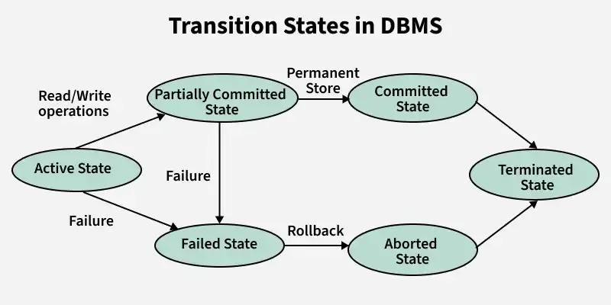
Worked Example
SLIDE 9 / 14
Numerical Calculation
INITIAL BALANCE A
2000, Initial Balance B: 1500.
TRANSACTION STARTS
BEGIN TRANSACTION.
FINAL STATE
Balance A is 2000, Balance B is 1500.
NET CHANGE
Zero, demonstrating perfect recovery from failure.
• After Step 1: Balance A becomes 1500 (2000 - 500).
• Error occurs before Step 2: System triggers implicit ROLLBACK.
Source: media.geeksforgeeks.org
Chandigarh University
9 / 14
Notes:
Let's look at the numbers. Initial Balance A is 2000 and Balance B is 1500. After Step 1, Balance A becomes 1500. If an error occurs before Step 2, the system triggers an implicit ROLLBACK. The final state shows Balance A is 2000 and Balance B is 1500. This net change of zero demonstrates perfect recovery from failure.

Slide 10
Common Pitfalls
SLIDE 10 / 14
Auto-Commit
1
Many clients enable auto-commit by default for every single statement.
2
This prevents grouping multiple statements into a single logical transaction.
3
A failure in the second statement leaves the first permanently committed.
4
Developers must explicitly disable auto-commit for multi-step operations.
5
Always verify the connection settings before writing transaction logic.
6
Implicit commits can occur after DDL statements like CREATE or DROP.
Chandigarh University
10 / 14
Notes:
Many clients enable auto-commit by default for every single statement. This prevents grouping multiple statements into a single logical transaction. A failure in the second statement leaves the first permanently committed. Developers must explicitly disable auto-commit for multi-step operations to ensure safety.

Slide 11
Common Pitfalls
SLIDE 11 / 14
Long Transactions
1
Long-running transactions hold locks for extended periods unnecessarily.
2
This causes blocking and reduces concurrency for other users significantly.
3
Deadlocks can occur when two transactions wait for each other's locks.
4
Keep transactions short by performing only essential database operations.
5
Move complex calculations to the application layer before committing.
6
Optimize query performance to reduce the time locks are held.
Chandigarh University
11 / 14
Notes:
Long-running transactions hold locks for extended periods unnecessarily. This causes blocking and reduces concurrency for other users significantly. Deadlocks can occur when two transactions wait for each other's locks. Keep transactions short by performing only essential database operations to maintain performance.

Slide 12
Common Pitfalls
SLIDE 12 / 14
Nested Savepoints
1
Savepoints can be nested, but rollback logic can become complex.
2
Rolling back to an outer savepoint undoes all inner savepoints.
3
Naming conflicts can occur if markers are not unique per transaction.
4
Overuse of savepoints can degrade performance due to log overhead.
5
Use savepoints only when partial recovery is strictly required.
6
Always release savepoints after use to free system resources.
Chandigarh University
12 / 14
Notes:
Savepoints can be nested, but rollback logic can become complex. Rolling back to an outer savepoint undoes all inner savepoints completely. Naming conflicts can occur if markers are not unique per transaction. Overuse of savepoints can degrade performance due to log overhead. Use savepoints only when partial recovery is strictly required.

Slide 13
Lecture
SLIDE 13 / 14
Key Takeaways
1
COMMIT permanently saves changes and releases locks immediately.
2
ROLLBACK undoes all changes and restores the previous database state.
3
SAVEPOINT allows partial rollback within a long transaction sequence.
4
Always disable auto-commit for multi-step logical operations.
5
Keep transactions short to maximize concurrency and prevent deadlocks.
Chandigarh University
13 / 14
Notes:
To summarize, COMMIT permanently saves changes and releases locks immediately. ROLLBACK undoes all changes and restores the previous database state. SAVEPOINT allows partial rollback within a long transaction sequence. Always disable auto-commit for multi-step logical operations. Keep transactions short to maximize concurrency and prevent deadlocks.

Slide 14
Lecture
SLIDE 14 / 14
References
1
Fundamentals of Database Systems — Ramez Elmasri & Shamkant B. Navathe
2
Database System Concepts — Silberschatz, Korth & Sudarshan
3
Database Management Systems — Raghu Ramakrishnan & Johannes Gehrke
4
Oracle/MySQL Documentation — Oracle
Chandigarh University
14 / 14
Notes:
For further reading, please refer to the Fundamentals of Database Systems by Elmasri and Navathe. You should also consult Database System Concepts by Silberschatz, Korth, and Sudarshan. The Database Management Systems book by Ramakrishnan and Gehrke is also essential. Finally, check the Oracle and MySQL documentation for specific syntax details.

